Slide 1

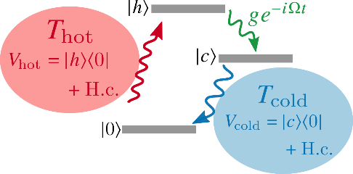
Quantum thermodynamics with non-Markovian and non-perturbative bath
Y. Tanimura
Department of Chemistry, Kyoto University
1. A heat bath, the secret garden (why positivity problem occur?)
Y. Tanimura, J. Phys. Soc. Jpn. 75 082001 (2006). (HEOM review)
Y. Tanimura, J. Chem. Phys. 141, 044114 (2014). (spin-boson)
Y. Tanimura, J. Chem. Phys. 142, 144110 (2015). (Brownian)
a trilogy
2. HEOM for entangled initial state
Y. Tanimura & R. Kubo, JPSJ 58, 101 (1989).
Y. Tanimura, PRA 41, 6676 (90)
3. Application to quantum heat engine
A. Kato and Y. Tanimura, J. Chem. Phys. 143, 064107 (2015)
A. Kato and Y. Tanimura, J. Chem. Phys. 145, 224105 (2016).

Slide 2
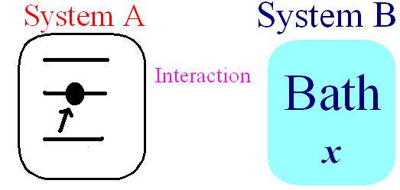
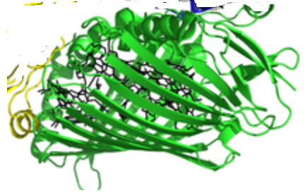
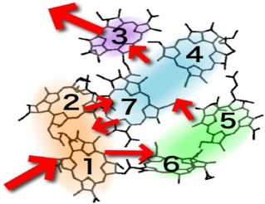

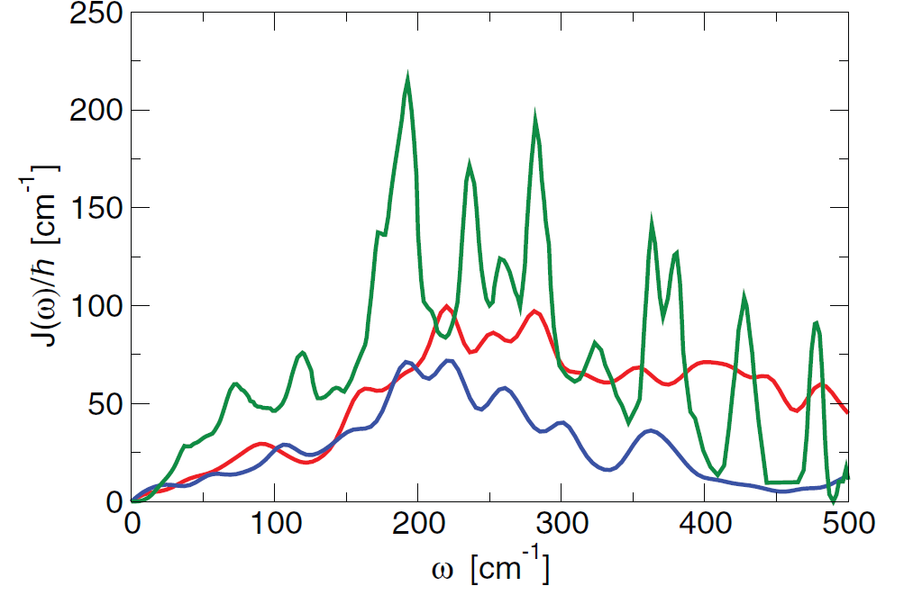

Quantum Environment
(strongly coupled & nonMarkovian)
$$+$$
Main system A
Bath system B
Valleau, Eisfeld, Aspuru-Guzik, JCP(2012)

Slide 3
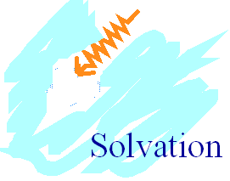


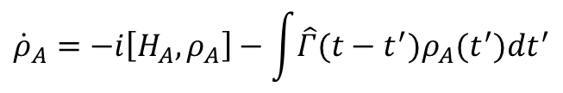
Reduced Density Matrix
For wave func. , density matrix elements are
Physical observable like dipole moment is defined by
If is a function of A only, we can rewrite
where
$${\dot{ρ}}_{A}=−i\left[H_{A},ρ_{A}\right]−\int{\hat{Γ}(t−t^{′})ρ_{A}(t^{′})dt^{′}}$$
Generalized master equation (2nd order perturbative theory)
reduced density matrices Energy does not conserve

Slide 4
non-factorized (entangled) equilibrium initial cond.
Influence Functional with correlated initial condition
Wave function in path integral form is
Reduced density matrix
The system+bath is in equilibrium at
Here, the Euclid action is

Slide 5
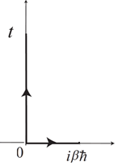
Feynman propagator
Harmonic oscillator with external force
system-bath interaction
Wick Rotation
After the trace
Euclid Action can be obtained by
Wick Rotation

Slide 6
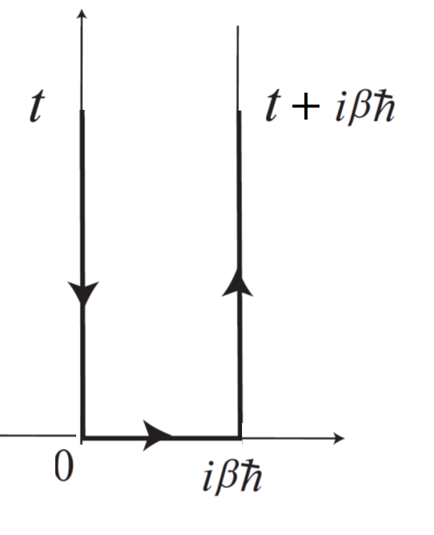
non-factorized equilibrium state
Reduced density matrix in path integral expression is
Dissipation
Harmonic oscillator with external force
Fluctuation
Dynamical
S-B correlation
Initial S-B correlation
We rewrite it as
Tanimura: JCP 141, 044114 (2014).
Real-Time HEOM
Im-Time HEOM

Slide 7


where
dissipation
fluctuation
Non-Markovian correlation between imaginary and real times.
Influence func.
in Im time

Slide 8
Four important functions of the bath
(non-Markovian tests; Tanimura, JCP 142, 144110 (2015).)
Fluctuation (heating)
Dissipation (relaxation)
iii) Static system-bath entanglement
iv) Dynamical system-bath entanglement
Reveals only through non-linear response function
Balanced at equilibrium state
fluctuation-dissipation theorem
(origin of positivity problem)
$\left(iH_{A}^{×}+Γ_{A}\right)$:
time-propagator
for reduced system

Slide 9
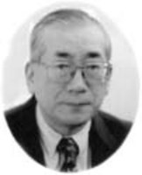
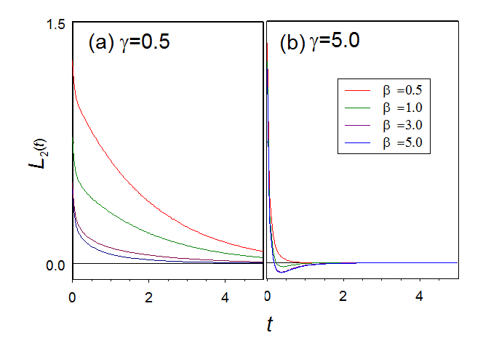

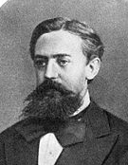
The origin of the positivity problem
for large
(Ohmic)
Dissipation:
Fluctuation:
Dissipation
Fluctuation
(slow)
(fast)
Matsubara
Approach to
Markovian
High T
(classical)
Low T
(quantum)
Becomes negative
Cannot be Markovian
Non-Markov
Markov

Slide 10

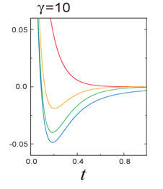
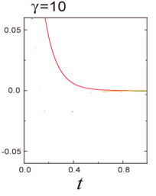
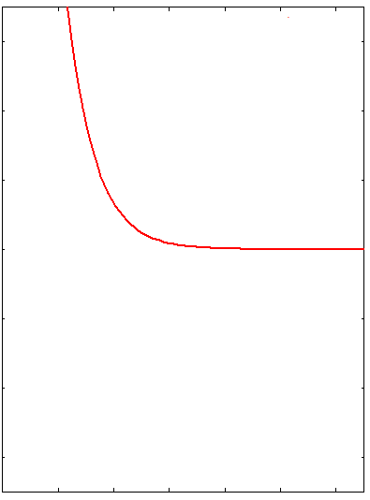
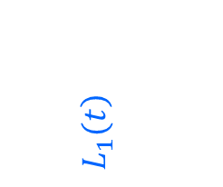
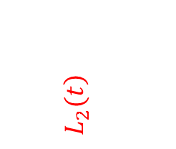
High temperature correlated case
If we assume
High T
$$\left.L_{1}(t\right)$$
$$\left.L_{2}(t\right)$$
Dissipation
YT JPSJ 75, 082001(2006).
Fluctuation
at high temperature

Slide 11
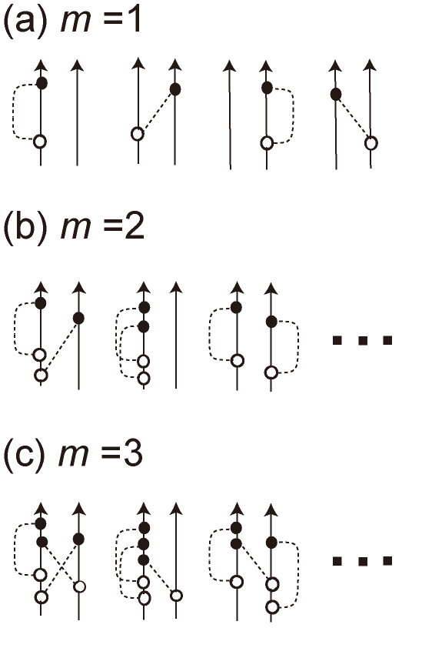

Density Matrix element
(correlated (entangled) initial condition)
(factorized initial condition)
Initial correlation
where
Dissipation
Fluctuation
Initial correlation
Time derivative of each terms are

Slide 12


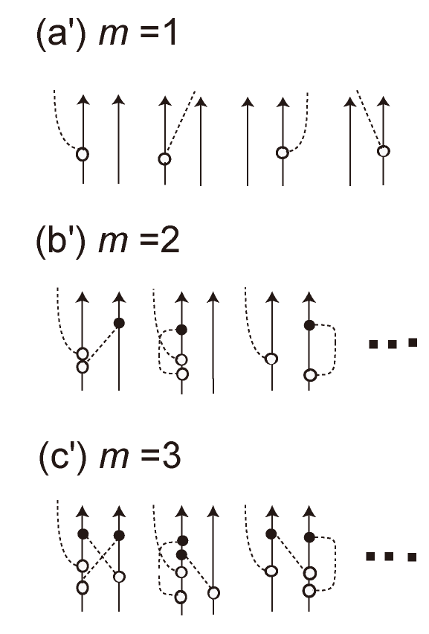
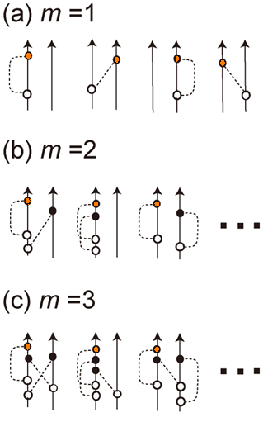
Consider the time derivative of the density matrix:
where
Then
(0th : exact)

Slide 13

We may evaluate by
then
where is the density matrix for the element
Original density matrix

Slide 14
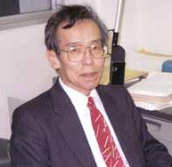


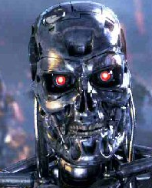
Hierarchal Equations of Motion
Quantal doctor equation
YT & R. Kubo, JPSJ 58, 101 (1989).
dissipation
fluctuation
Dissipation & Fluctuation
balanced at eq. state
terminator
terminator
YT & Wolynes, PRA43, 4131(1991).
YT JCP120, 260 (2004).

Slide 15
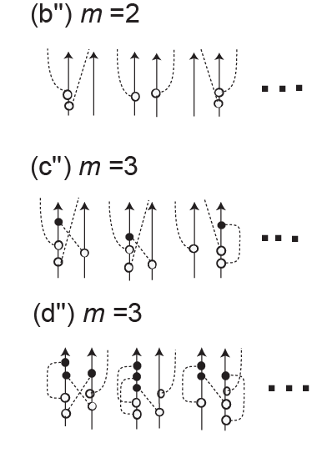
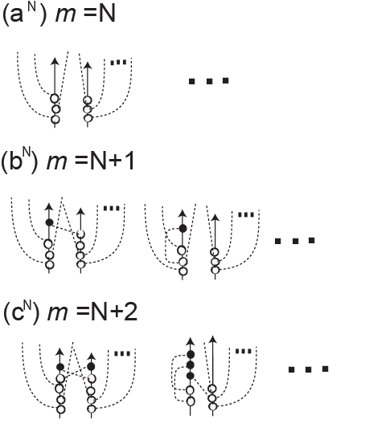
Physical meaning of the hierachy elements
(0th member: exact)
(1st member: 1th lower)
(2nd member: 2nd lower)
(N^{th} member: N^{th} lower)
member is grouped by
characteristic time
Dashed line represents the system-bath interactions
Correlated initial condition can be set by
Tanimura:J. Phys. Soc. Jpn 75,082001(2006).
Terminator

Slide 16
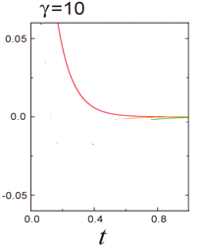



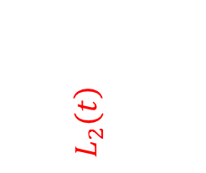
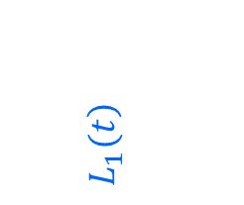
Low temperature correction terms
Tanimura, PRA 41, 6676 (90).
Dissipation
High T
$$\left.L_{1}(t\right)$$
$$\left.L_{2}(t\right)$$
Low T
Fluctuation
YT JPSJ 75, 082001(2006).
Similar to GM case
Matsubara freq. correct. terms
High freq. terms
are approximated by this (important for normalizaion)
Ishizaki & YT, JPSJ74, 3131(2005)
YT, JPSJ 75 082001 (2006).

Slide 17
Time derivative of the density matrices
Tanimura, PRA 41, 6676 (90).
Ishizaki & YT, JPSJ74, 3131(05)
where
Witt, Rudnicki, YT, & Mintert, Exploring complete positivity in HEOM, NJP 19, 013007 (2017)

Slide 18
Difference is in the initial state (correlated initial state)
At t =0
Correlated initial equilibrium state is set by the HEOM members
(they are the steady state solution of HEOM)
(with the above initial condition)
Y. Tanimura, J. Chem. Phys. 141, 044114 (2014).
Y. Tanimura, J. Chem. Phys. 142, 144110 (2015).

Slide 19
Imaginary time HEOM (t=0, τ=1/βhω)
The equilibrium distribution for Drude spectrum
For

Slide 20
Imaginary-time HEOM (definite integrals)
Tanimura: JCP141, 044114 (2014).
Tanimura, JCP 142, 144110 (2015)
for large m

Slide 21
Thermodynamic variables
Partition function:
Free Energy:
Entropy:
Internal Energy:
Heat capacity:
Susceptibility: (for )

Slide 22
For Spin-Boson system
Dashed curves represent bath-less cases
Tanimura: JCP 141, 044114 (2014).
Tanimura, JCP 142, 144110 (2015)

Slide 23
Four important effects of the bath
(non-Markovian tests; Tanimura, JCP 142, 144110 (2015).)
Fluctuation (heating)
Dissipation (relaxation)
iii) Static system-bath coherence (entanglement)
iv) Dynamical system-bath coherence (entanglement)
Reveals only through non-linear response function
Balanced at equilibrium state
fluctuation-dissipation theorem
(positivity problem)
$\left(iH_{A}^{×}+Γ_{A}\right)$:
time-propagator
for reduced system

Slide 24
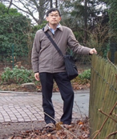
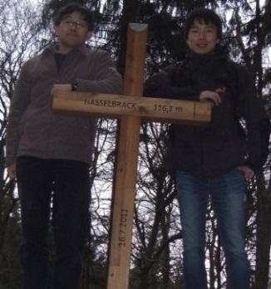
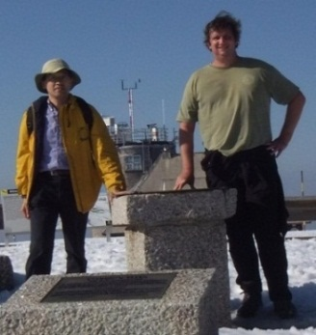


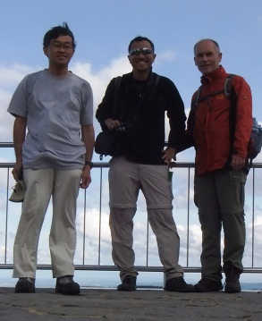


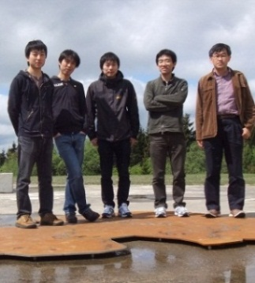
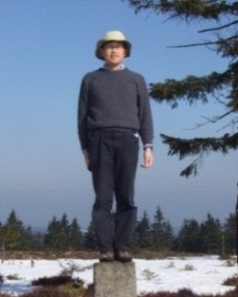
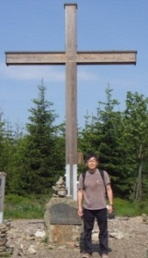
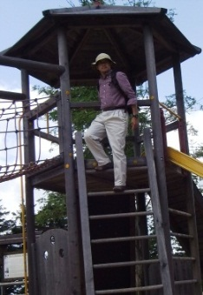
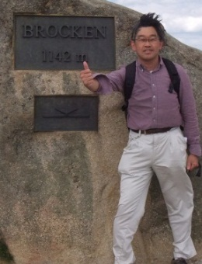
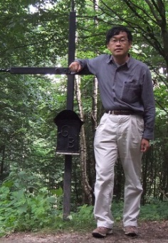
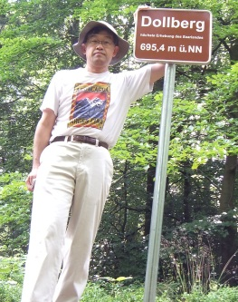

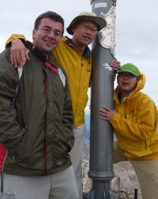
High points of Germany 16 states
Friedhorstpark (31m)
Hasselbrack(116m)
Feldberg (1492m)
Wasserkuppe
(950m)
Müggelberge (115.4m)
Fichtelberg (1215m)
Heideberg (201m)
Bremen (23.2.2012)
Hamburg (11.3.2012)
Baden-Württemberg
(16.3.2012)
Saxsony (14.7.’12)
Brandenburg
(15.7.’12)
Hessen(18.3.'12)
Berlin(17.6.’12)
Bungsberg (167m)
Erbeskopf (818m)
Beerberg, (982m)
Langenberg, (843m)
Wurmberg, (971m)
Brocken(1142m)
Helpter Berg (179.5m)
Dollberg (695m)
Schleswig-Holstein
(31.3.2012)
Rhineland-Palatinate
(12.5.2012)
Thüringen
(22.3.2012)
North Rhine-
Westphalia
(23.5.2012)
Sachen-Anhalt
(9.6.2012)
Saarland
(21.7.2012)
Lower Saxony
(9.6.2012)
Mechlengurg-
Vorpommem
(17.6.2012)
Zugspitze (2962m)
Bavaria
(29.9.2012)

Slide 25
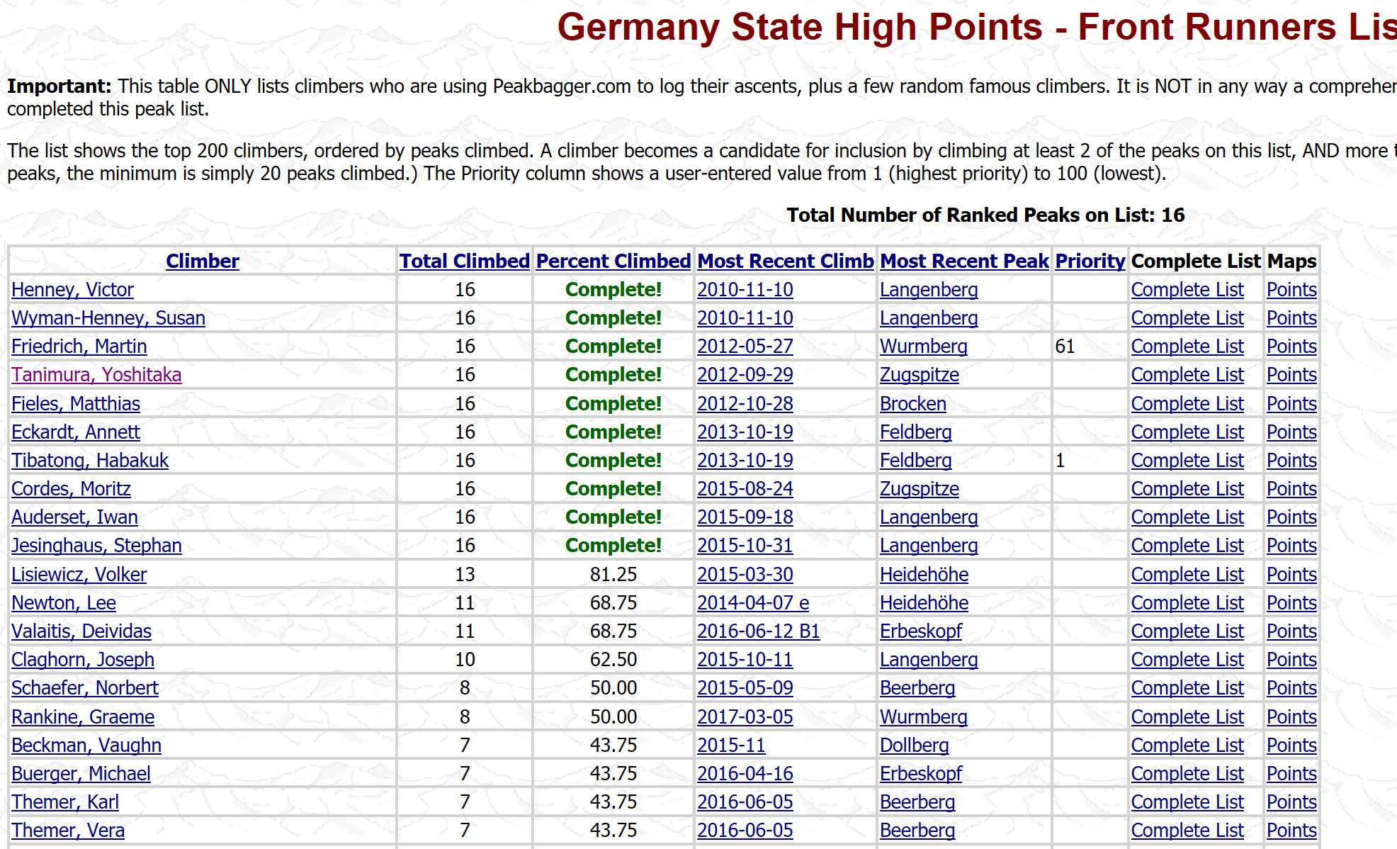

Slide 26
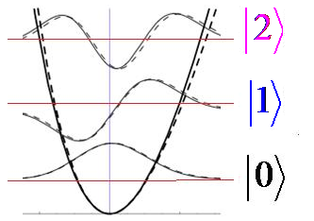
Tanimura, JCP 142, 144110 (2015).
Fortran codes are also there in
Non-Markovian Tests
For any spectral distribution
Brownian oscillator
(Grabert, Scharmm, Ingold . Phys Rep. 1980)
(eigen state for spin-Boson)
i) Fluctuation (temperature effects)
Symmetric correlation
For any spectral distribution
ii) Dissipation (non-Markovian effect)
1st order response function (temperature independent)

Slide 27
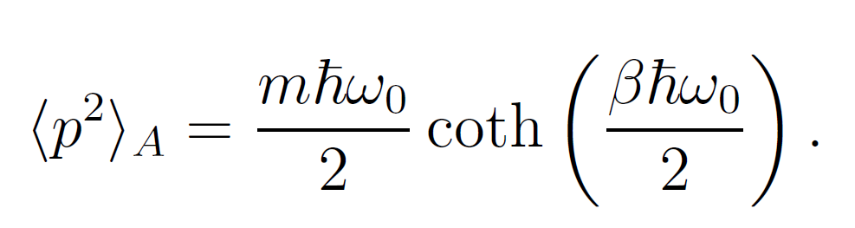
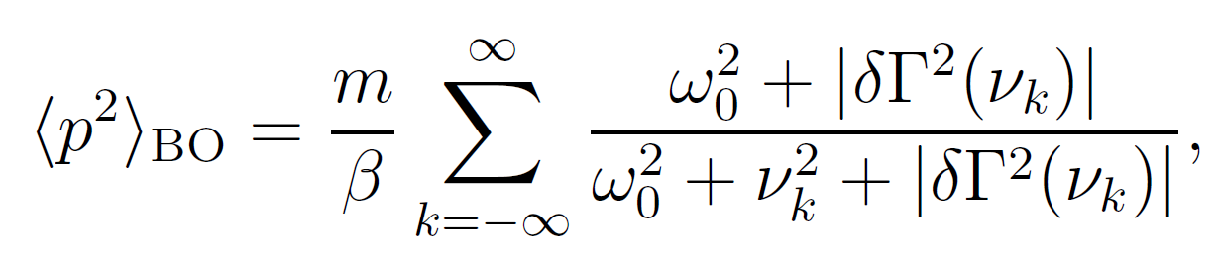
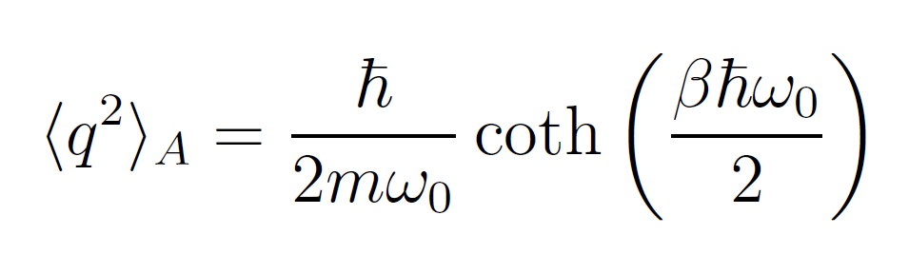
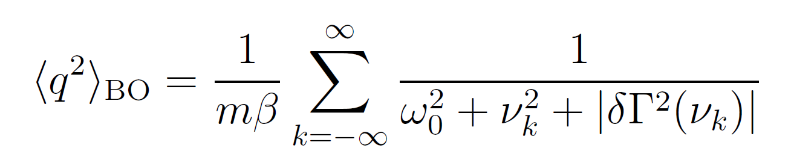
iii) Static system-bath coherence
Equilibrium distribution
Factorized case (system itself)
nonFactorized case (static correlation)
iv) Dynamical system-bath coherence (2D spectrum)
( = capability of handling a time-dependent external force)
Tanimura & Mukamel JCP 1993

Slide 28
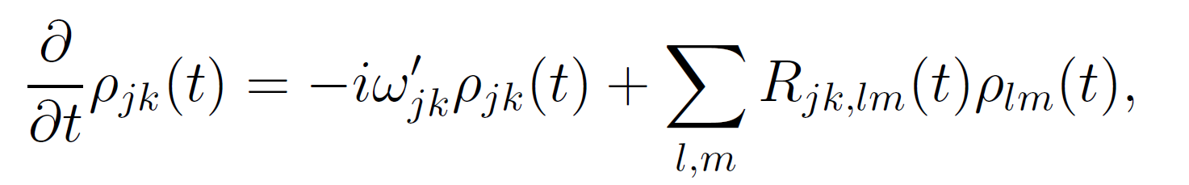
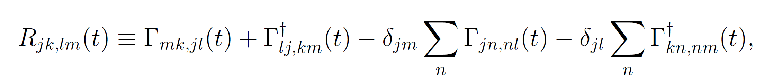
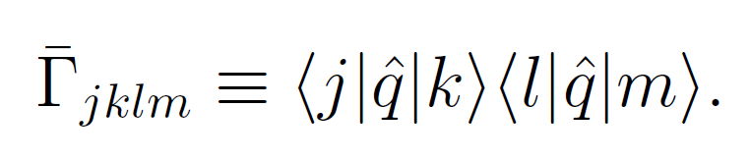
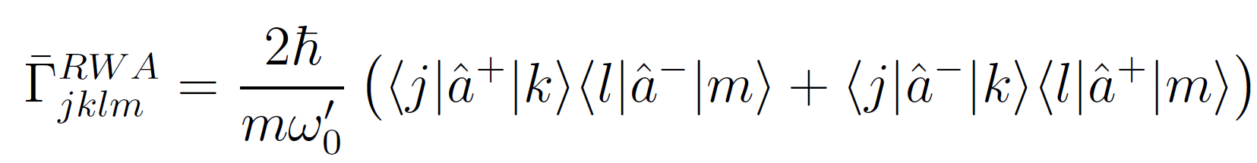
HEOM vs. TCL-Redfield
Time-ConvolutionLess (TCL) Redfield Eqs.
where the Redfield tensor is defined by
Without RWA:
positivity problem
With RWA:
Does not satisfy the Fluctuation-dissipation theorem

Slide 29
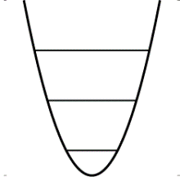

i) Fluctuation (temperature)
Symmetric correlation
Grabert, etc. Phys Rep.
Tanimura, JCP 142, 144110 (2015)

Slide 30

ii) Dissipation (relaxation)
1st order response function (temperature independent)
Grabert, etc. Phys Rep.
Non-Markovian
Bosonic peak

Slide 31



iii) Static system-bath coherence
HEOM vs. TCL Readfield
factorized state unfactorized
For harmonic system
Y. Tanimura, JCP 142, 144110 (2015)

Slide 32

iv) Dynamical s-b coherence
( = capability of handling a time-dependent external force)
2nd order response function (2D Raman response)
Tanimura & Mukamel JCP 1993
Lack of dynamical correlation
exact:
factorized:

Slide 33

http://theochem.kuchem.kyoto-u.ac.jp/tanimura/

Slide 34







Our recent applications of HEOM
Quantum Ratchet
Kato and YT, JPC. B 117, 13132 (2013).
Kato(加藤)
Resonant tunneling Diode
Sakurai & YT, JPSJ 82, 033707 (2013).
Sakurai & YT, NJP 16, 015002 (2014).
Grossman, Sakurai & YT, JPSJ 85, 034803 (2016).
Self current oscilation
Sakurai
(櫻井)

Slide 35


Quantum spin glass system
Our GPU-HEOM can handle 4096 energy eigenstates
Free induction decay of quantum spin glass system
Tsuchimoto & Tanimura,
J. Comput. Theor. Chem. 11, 3859 (2015)
(GPU code is therein)
HEOM for Holstein Hamiltonian
L. Chen, Y. Zhao, and Y. Tanimura,
J. Phys. Chem. Let. 6, 3110 (2015).

Slide 36

温故知新
try to find a guide into tomorrow by taking lessons from the past.
Students projects
Quantum Ratchet
resonant tunneling diode
SQUID
Proton & electron transfer
Ryogo Kubo(久保亮五)
Why don't you study your research instead of attending tons of conferences. (R. Kubo)

Slide 37





Quantum measures
Dijkstra & YT, PRL, 104, 250401(2010)
Dijkstra (U. Leeds)
two-qubit system coupled to independent bath

Slide 38

Concurrence (measure of entanglement)
: Eigen values of and
Hearachal eq.
Master eq.
Readfield w. Markov
(positibity)
Readfield w. secular & Markov
Dijkstra & YT,
PRL, 104, 250401(2010)

Slide 39


Quantum heat transport of qubits system
Kato & Tanimura, JCP 143, 064107 (2015)
Kato
high temp
low temp

Slide 40



Quantum heat engine & 2nd low
A. Kato and YT, J. Chem. Phys, 145, 224105 (2016). [JCP editor’s pick]
Kato
Non-Equilibrium Spin-Boson Model
$V_{h}=σ_{x}$ $V_{c}=σ_{x}+σ_{z}$
Three-level quantum heat engine model 1

Slide 41






Two definitions of heat current
System heat current
Bath heat current
work
They are relate through
Coherent flow
Correlations among system-bath interactions (CASBIs)

Slide 42




Kato&YT, JCP 145, 224105 (2016).
[JCP editor’s pick]
Non-Equilibrium Spin-Boson Model
Bath heat
current
System heat
current
negative value
Bath correlation
non-commutable effect
Negative heat current (system) for large coupling
System heat
current
Violation of the Clausius inequality
Bath correlation term fixes the problem!

Slide 43




Three-level quantum heat engine model
Hamiltonian：
Inversion condition :
Efficiency：

Slide 44


Time-dependence of heat currents
For Different System-Bath 1 coupling
Weak
Intermediate
Strong

Slide 45


Three-level quantum heat engine model 2
A. Kato and Y. Tanimura, J. Chem. Phys, 145, 224105 (2016). [JCP Editors’ pick]
System heat
current
Bath heat
current
Bath heat
current
System heat
current
: constant value
is decreasing function :
increase of the bath entropy via
the system interaction

Slide 46

Photo induced isomerization
S. Ruhman et al. ARPC 2013, 64:437-58
Retinal
Notes:
This is an introduction.
As you know, nonadiabatic transition processes are important to understand behavior of chemical reactions.
Especially, analysis of photo-induced chemical processes has played an important roles in the study of reaction dynamics in condensed phase.
These are two examples of the molecules that are investigated using optical spectroscopic techniques.
This is a stilbene molecule and this potential is schematic illustration of cis-trans isomerization of stilbene in hexane solution. When we excite cis-stilbene using laser pulses, excited distribution moves towards crossing region labeled P, and then nonadiabatic transition occurs and we obtain cis or trans stilbene as products.
This is a retinal molecule. Retinal exists in our eyes as rhodopsin, and its photoisomerization plays an essential role in the mechanism of our vision. This is a schematic illustration of photoisomerization of a retinal molecule in bacteriorhodopsin. In bacteriorhodopsin, a retinal molecule exists as a part of protein-pigment complex. So we need to treat effects of protein molecules that act like heat bath.
Experimentally, these are well investigated using pump-probe spectroscopy. But theoretically, because these dynamics occur in condensed phase as I explained, we need a theory about quantum dissipative systems to understand their behavior.

Slide 47


Dynamics of Wavepackets
Displaced Morse potentials
Notes:
Then I will show some numerical results about displaced Morse potentials system as a demonstration.
The potentials are like this figure.
These are time evolution of excited wavepackets.
The excited wavepacket passes through a crossing region maintaining a large momentum, and as a results, the adiabatic
approximation breaks down and non-adiabatic transition occur, like this.
Thus, it is seen that using the distribution function in phase space, we can analyze the behavior of nonadiabatic processes more completely than if we use only the distribution function in coordinate space.

Slide 48






Transient absorption & 2D correlation spectra
T. Ikeda and Y. Tanimura, J. Chem. Phys. submitted
Notes:
I also show some results of calculation for nonlinear optical spectra.
This is a transient absorption spectrum and these are 2-dimensional correlation spectra.
The red and blue areas represent emission and absorption, respectively.
This horizontal axis represents waiting time and vertical axis represents frequency.
This peak that is distributed about twenty thousand is caused by bleaching of ground state.
When waiting time is zero, there is also a peak caused by stimulated emission at the same position, like this.
When waiting time increases, the peak caused by stimulated emission moves in the direction of decreasing its frequency, because the excited wavepacket moves in the direction of decreasing the energy difference between ground and excited states. So strong and fast time-dependent Stokes shift is observed.
And when the excited wavepacket approaches the crossing point, nonadibatic transition occurs and because of this, absorption peak appears.
Thus, by calculating nonlinear spectra, we can relate dynamics of wavepackets and optical measurement more clealy.

Slide 49

Conclusion
Real-time and Imaginary-time HEOM
non-perturbative and non-Markovian dynamics
Non-Markovian tests (justification of formalism)
Quantum heat transport
system vs bath heat currents (Clausius inequality)
heat engine: cyclic heat flows
Mr. Ikeda
Mr. Kato
Power Point Lecture note for HEOM & codes (nonMarkovian08, Tanimuran15, etc)
are on my homepage (http://theochem.kuchem.kyoto-u.ac.jp)

